Slide 1


By Tue Thu
2026/01/09

Slide 2

Outline
Executive Summary
Introduction
Methodology
Results
Conclusions

Slide 3
Executive Summary
The objective of this project is twofold:
To evaluate the economic viability of each SpaceX launch and determine whether reusing the first-stage booster is necessary by training a machine learning model using publicly available data.
Based on the above results, make SpaceY more affordable to compete with SpaceX.
Methodologies: The project followed the full data science lifecycle, including:
Data collection through API and web scraping
Data Wrangling
Exploratory Data Analysis (EDA)
Interactive Visual Analytics and Dashboards with Folium and Plotly Dash
Predictive Analysis (classification)
Results
Among the 4 tested algorithms—Logistic Regression, Support Vector Machine (SVM), Decision Tree, and K-Nearest Neighbors (KNN)—the Logistic Regression model achieved the highest accuracy at 93% for the whole dataset

Slide 4
Introduction
SpaceX has transformed the aerospace industry through the development of its reusable Falcon 9 launch system. It can cut launch costs from more than $165 million to roughly $62 million. This breakthrough in reusability delivers significant economic and technological benefits.
Accurately predicting the landing success of the Falcon 9 first stage is crucial for mission planning and cost estimation, and it provides valuable insights for stakeholders involved in space operations, logistics, and investment.
This project aims to develop a machine learning model that forecasts landing outcomes by gathering data from an API, specifically the SpaceX REST API. By applying the complete data science workflow—data acquisition, preprocessing, exploratory analysis, and predictive modeling—we identify the key drivers of successful landings and deliver a practical, data‑driven tool for the aerospace sector.

Slide 5

Section 1

Slide 6
Methodology
Data collection methodology:
Data was collected through requests to the SpaceX API and additional web scraping from Wikipedia.
Perform data wrangling
The collected data is saved in JSON form ad HTML tables
After that, Pandas and NumPy were used to clean, organize, and manage the dataset for further visualization and analysis
Perform exploratory data analysis (EDA) using visualization and SQL.
Perform interactive visual analytics using Folium and Plotly Dash.
Perform predictive analysis using classification models
Several classification models were tested, with K‑Nearest Neighbors (KNN) achieving the lowest performance at 77.8% accuracy.

Slide 7
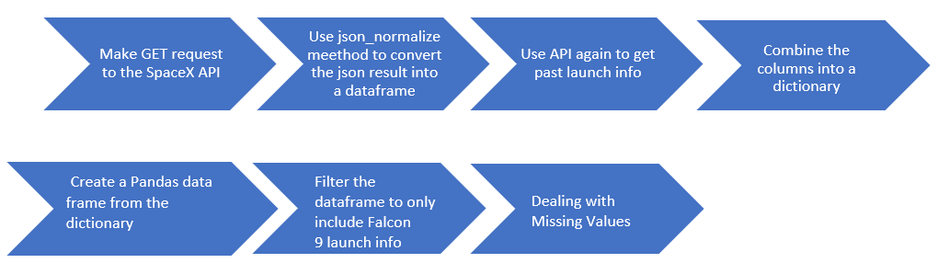
Data Collection
The data for the following final project was collected using two different techniques.
Request and parse the SpaceX launch data using the GET request
In this method, we only include Falcon 9 launches, use the mean for the for the PayloadMass then replace the missing data (np.nan values) with the mean we calculated.
Link to the notebook

Slide 8
Data Collection – SpaceX API
2. Web scraping with BeautifulSoup
2.1. Request the Falcon9 Launch Wiki page from the below URL to extract and compile to the launch records HTML table
https://en.wikipedia.org/wiki/List_of_Falcon_9_and_Falcon_Heavy_launches
2.2. Extract (Parse) all column/variable names from the HTML table header and convert it into a Pandas data frame
The full step‑by‑step extraction procedure can be found at:
Link to the notebook

Slide 9
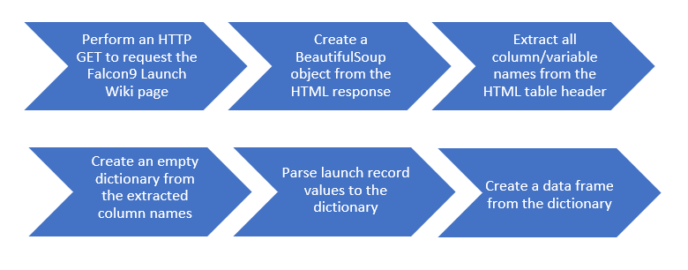
Data Collection - Scraping
In this project, we used BeautifulSoup to build a web archive of Falcon 9 launch logs and extracted the corresponding HTML table from Wikipedia. The table’s columns were then scraped and processed using web‑scraping techniques to construct a clean Pandas DataFrame, as shown below:
Link to the notebook

Slide 10
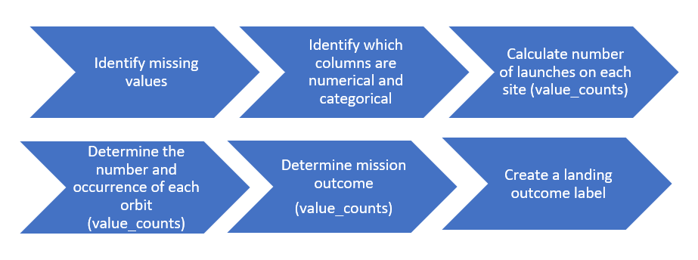
Data Wrangling
We examined the dataset to identify data types and check for any missing, duplicate, or null values. This process followed the workflow illustrated in the flowchart below.
You can also review the full procedure at:
Link to the notebook

Slide 11
EDA with Data Visualization
For this analysis, we created three types of visualizations using Pandas, Matplotlib, and Seaborn:
1. Scatter plots to explore relationships between:
Flight Number and Launch Site
Payload Mass and Launch Site
FlightNumber and Orbit type
Payload Mass and Orbit type
2. Bar charts to reveal relationship between success rate of each orbit type
3. Line charts to identify trends over time such as launch success yearly trend
The complete analysis and all visualizations can be found here:
Link to the notebook

Slide 12
EDA with SQL
The SPACEXTABLE dataset was generated by filtering out records with zero or missing dates. From this table, we identified all unique launch sites, calculated the total payload delivered for NASA CRS missions, and computed the average payload for the Falcon 9 v1.1 variant. We also determined the date of the first successful landing, counted both successful and failed landing attempts, and identified the booster version that carried the heaviest payload. In addition, all pad landing failures that occurred in 2015 were extracted along with their relevant details.
Below are some SQL queries that have been performed:
Display 5 records where launch sites begin with the string 'CCA’
%%sql SELECT Launch_Site FROM SPACEXTABLE WHERE Launch_Site LIKE 'CCA%' LIMIT 5;
Display the total payload mass carried by boosters launched by NASA (CRS)
%%sql SELECT SUM(PAYLOAD_MASS__KG_) AS Total_Payload_Mass FROM SPACEXTABLE WHERE Customer = 'NASA (CRS)’;
The full, step‑by‑step process can be found here:
Link to the notebook

Slide 13
Build an Interactive Map with Folium
The map was constructed using several key Folium components:
folium.Map for generating the interactive base map
folium.Circle to highlight specific locations with informative circular overlays
folium.Marker to pinpoint launch sites
folium.MarkerCluster to group nearby markers and reduce visual clutter
MousePosition to display real‑time geographic coordinates as the cursor moves
folium.DivIcon to place custom HTML/CSS‑styled text directly on the map
folium.PolyLine to draw connecting lines between locations
folium.FeatureGroup to organize related map elements into manageable layers
Link to the notebook

Slide 14
Build a Dashboard with Plotly Dash
The Dash web application was built using the following components:
dcc.Dropdown to select a launch site and display the corresponding success‑versus‑failure distribution in a pie chart
dcc.RangeSlider to filter payload values and examine how payload size relates to launch success
dcc.Graph to render both the pie chart and scatter plot
Dash callbacks to enable dynamic, interactive updates between all interface elements
The visualizations included:
Pie Chart, illustrating the proportion of successful and failed launches for each site
Scatter Plot, showing the relationship between payload mass and launch outcome

Slide 15
Predictive Analysis (Classification)
We conducted the following tasks to predict if the first stage will land or not.
Load the dataframe
Create a NumPy array from the column Class in data
Standardize the data in X then reassign it to the variable X
Use the function train_test_split to split the data X and Y into training and test data
Create a logistic regression object then create a GridSearchCV object logreg_cv with cv = 10
Seach the best Hyperparameters for Logistic Regression, SVM, Decision Tree and KNN classifiers
Calculate the accuracy of each model and find out the best model
The complete process is available at:
Link to the notebook

Slide 16
Results
Exploratory Data Analysis Results:
The analysis confirmed that several key parameters have a direct impact on whether a landing succeeds or fails.
Interactive Analysis (Screenshots):
The visual exploration clearly showed how the choice of launch site influences the overall mission success rate.
Predictive Analysis Results:
A Logistic Regression model was developed, achieving an accuracy of 93% in predicting the success of SpaceX first‑stage landings.

Slide 17

Section 2

Slide 18
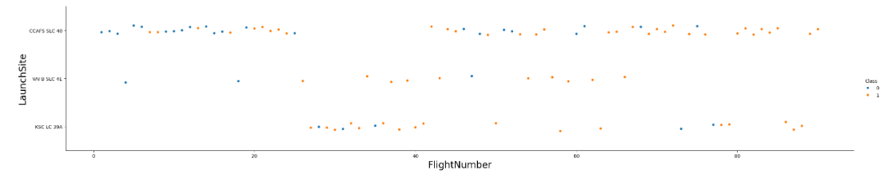
Flight Number vs. Launch Site
The visualization reveals a clear trend: as flight numbers increase, success rates improve across all launch sites.
CCAFS SLC‑40 stands out with significantly higher success rates compared to VAFB SLC‑4E and KSC LC‑39A.

Slide 19
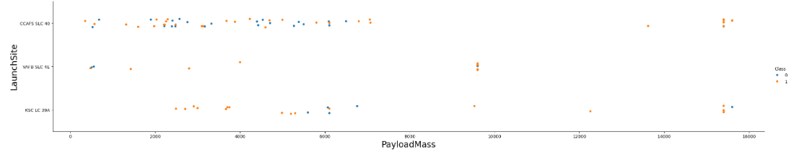
Payload vs. Launch Site
The graph highlights the differences in payload mass across the three launch sites.
CCAFS SLC‑40 has launched rockets carrying payloads below 7,000 kg and above 13,000 kg, with no launches recorded in the intermediate range.
VAFB SLC‑4E has only launched rockets with payload masses under 10,000 kg.
KSC LC‑39A has exclusively launched rockets with payloads greater than 2,500 kg.

Slide 20
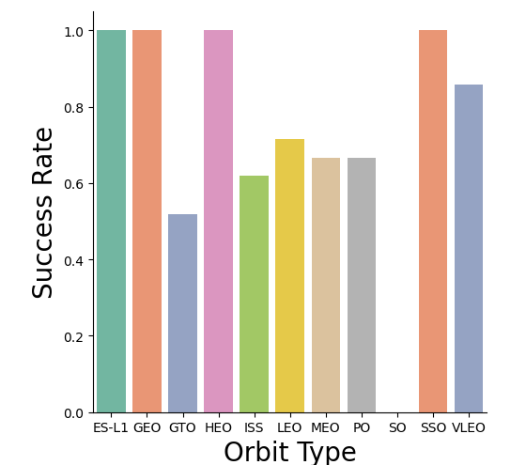
Success Rate vs. Orbit Type
The data indicates that the chosen orbit has a strong influence on mission success, with certain orbits performing considerably better than the rest such as ES-L1, GEO, HEO and SSO.

Slide 21
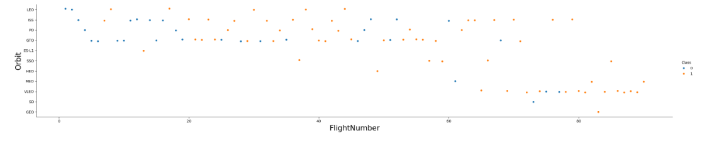
Flight Number vs. Orbit Type
The visualization reveals a clear pattern: as the number of flights increases, success rates rise across all orbits. Notably, after about 40 launches, the proportion of successful landings improves by more than 50%.
GTO and ISS missions show more failures than successful landings when compared with other orbits.
In contrast, SSO stands out with a perfect success rate—although this is based on only four launches, so the sample size is limited.

Slide 22
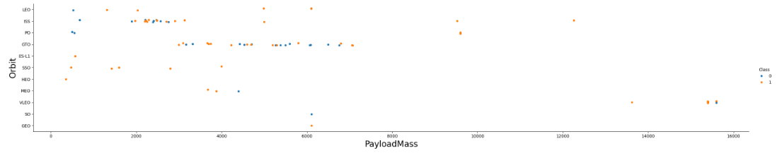
Payload vs. Orbit Type
A large portion of the payload masses across different orbits falls below 8,000 kg.
The ISS orbit shows consistently higher success rates across its range of payload masses.
In contrast, GTO missions display roughly a 50% success rate regardless of payload mass.

Slide 23
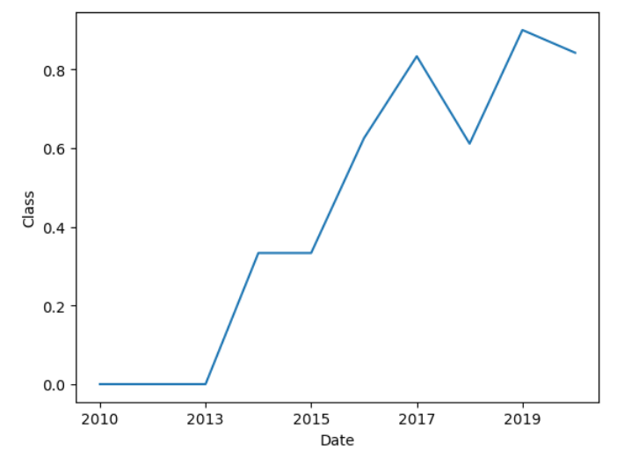
Launch Success Yearly Trend
This graph showcases SpaceX’s remarkable improvement in rocket reusability:
Early attempts had a 0% success rate, but by 2017 the company surpassed—and maintained—an 85% success rate.
The success rate from 2013 kept increasing until 2020
The trend demonstrates ongoing learning, stronger engineering, and continuous innovation.

Slide 24
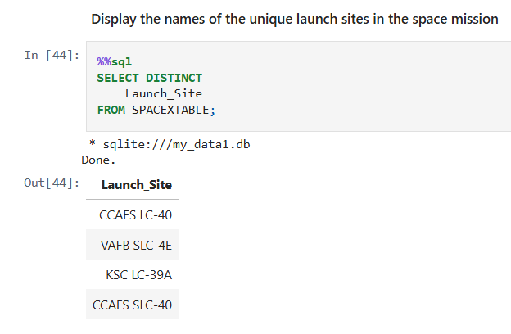
All Launch Site Names
This query retrieves and visualizes the four launch locations contained in our dataset, which are:
1. CCAFS LC-40
2. VAFB SLC-4E
3. KSC LC-39A
4. CCAFS SLC-40

Slide 25
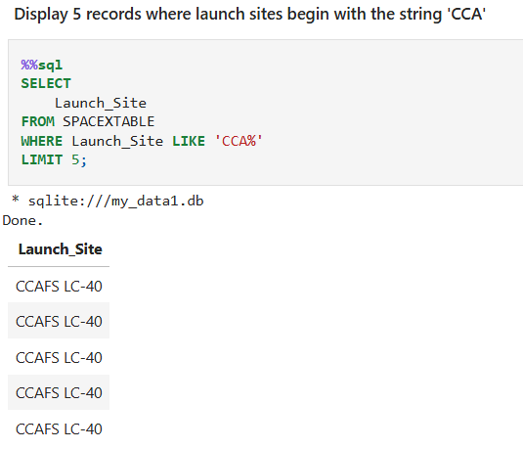
Launch Site Names Begin with 'CCA'
This query allowed us to view the first five records for the CCAFS LC‑40 launch site.
CCAFS LC-40
CCAFS LC-40
CCAFS LC-40
CCAFS LC-40
CCAFS LC-40

Slide 26
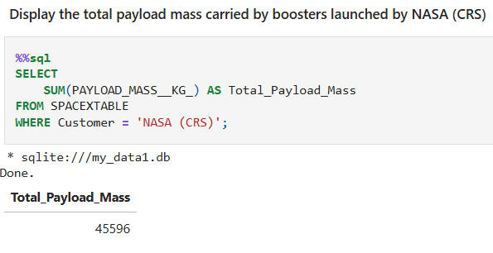
Total Payload Mass
The SQL query displayed in the image returns the total payload weight across all missions, yielding a value of 45,596 kg.

Slide 27
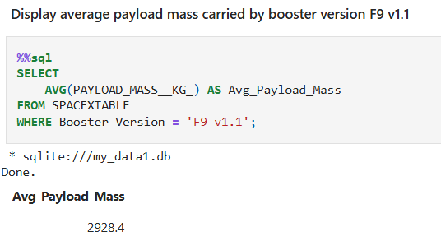
Average Payload Mass by F9 v1.1
The SQL query also provides the average payload weight per launch, which is 2928.4 kg.

Slide 28
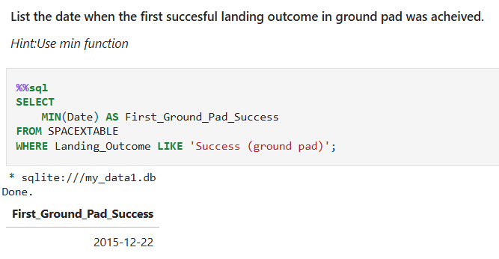
First Successful Ground Landing Date
From the SQL query displayed, we found that the earliest successful landing on the platform took place on 2015-12-22.

Slide 29
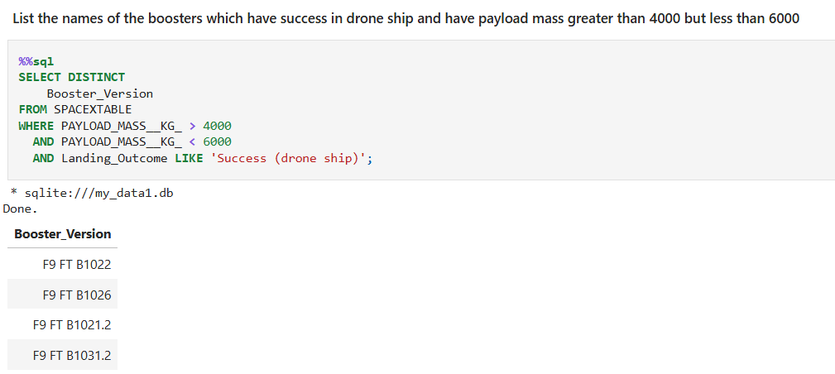
Successful Drone Ship Landing with Payload between 4000 and 6000
This SQL query allows us to retrieve all successful missions carrying payloads in the 4,000–6,000 kg range.
F9 FT B1022
F9 FT B1026
F9 FT B1021.2
F9 FT B1031.2

Slide 30
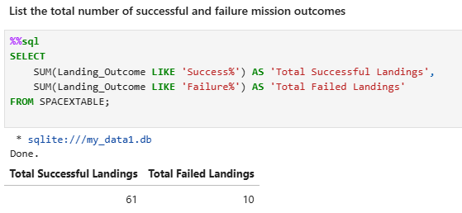
Total Number of Successful and Failure Mission Outcomes
The results of the query indicate that the outcome of missions were:
- 61 success
-10 failures

Slide 31
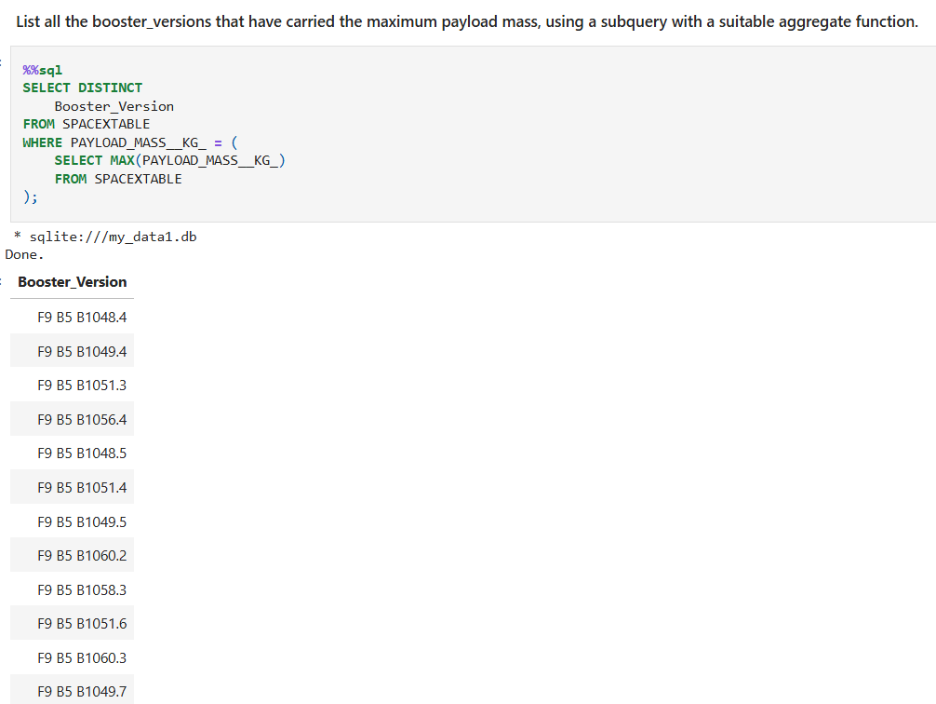
Boosters Carried Maximum Payload
As shown in the image below, this SQL query allowed us to list the 12 launches that carried their maximum payload.
F9 B5 B1048.4
F9 B5 B1049.4
F9 B5 B1051.3
F9 B5 B1056.4
F9 B5 B1048.5
F9 B5 B1051.4
F9 B5 B1049.5
F9 B5 B1060.2
F9 B5 B1058.3
F9 B5 B1051.6
F9 B5 B1060.3
F9 B5 B1049.7

Slide 32
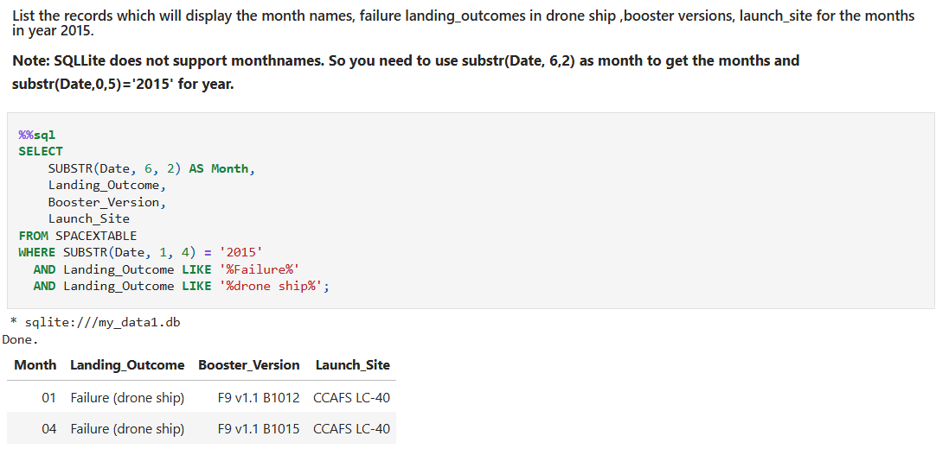
2015 Launch Records
The data shows that just two missions failed this year, both launched from the same site and separated by a three‑month interval.

Slide 33
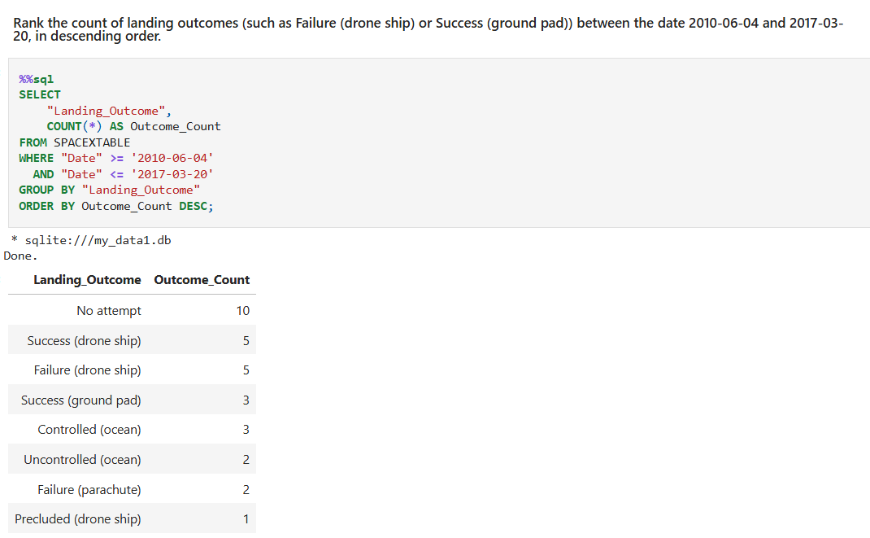
Rank Landing Outcomes Between 2010-06-04 and 2017-03-20
Finally, we summarize the number of positive outcomes by sorting them in descending order according to landing outcome type (e.g., failure on drone ship vs. success on ground platform) for missions launched between 2010/06/04 and 2017/03/20.

Slide 34

Section 3

Slide 35
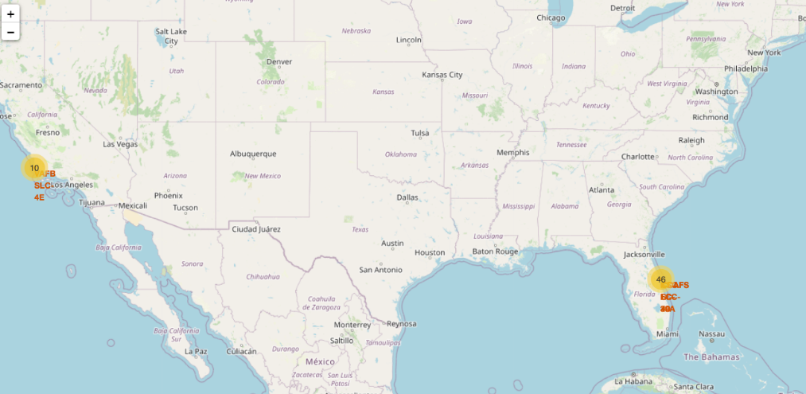
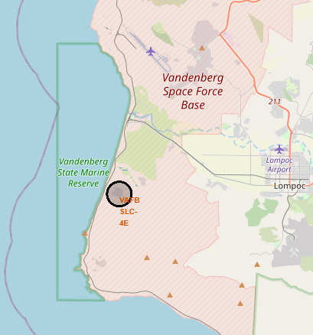
1- All launch sites with Folium
All launch sites are positioned close to the coast and, in some cases, nearer to the equator, likely to take advantage of Earth’s rotational boost and improve mission success.

Slide 36
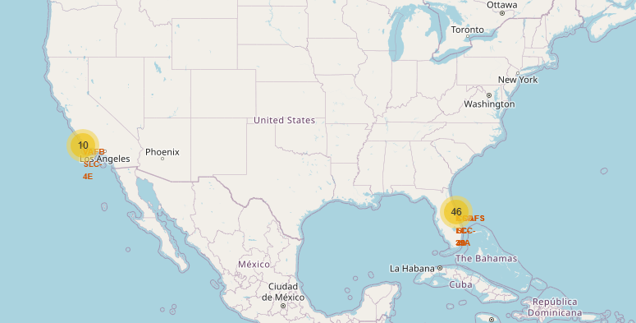
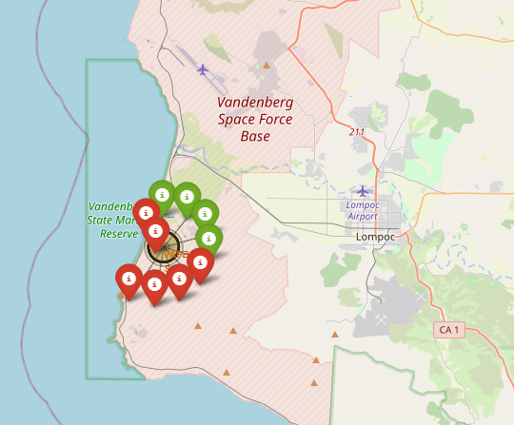
2- The launch results labeled by colors.
Green Marker: Successful launch(class=1)
Red Marker: Failed launch(class=0)

Slide 37
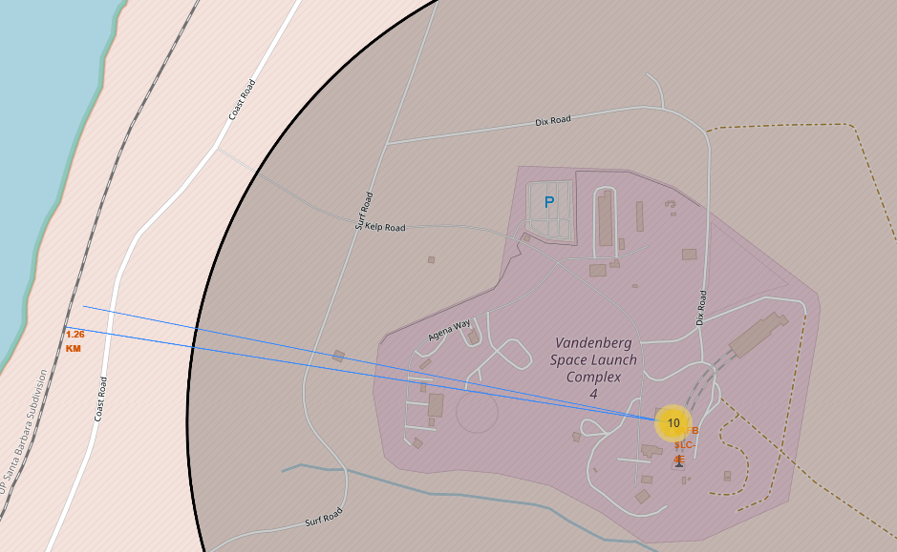
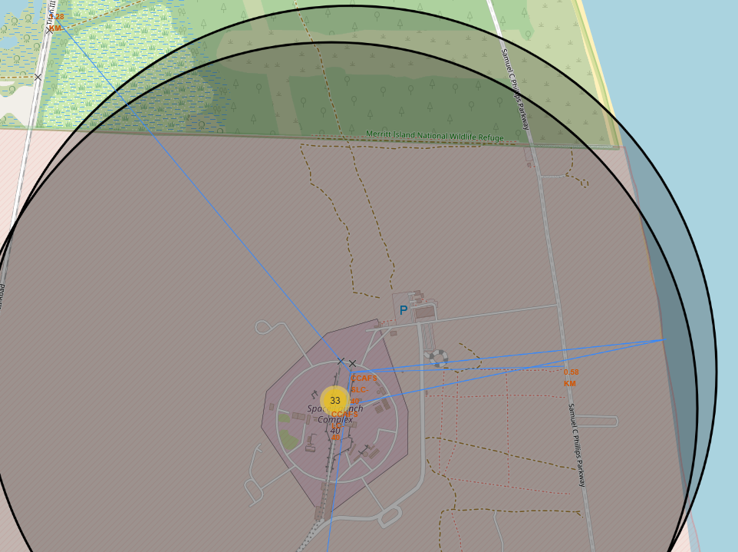
3- Launch location and distance to surrounding areas (cities, railways, etc.)
Launch sites are located nearby:
Railways for transporting large components and hazardous materials.
Coastlines so debris falls into the ocean and launches avoid populated areas.
Highways to move oversized rocket parts and equipment.
The equator to benefit from Earth’s rotational speed and improve launch efficiency.
They are far from cities to reduce risks from failures, noise, shockwaves, explosive fuels, and airspace disruption.

Slide 38
Analysis result
The first image shows the geographic distribution of the launch sites on a global map.
The second image highlights, using colored labels, the number of successful launches (in green) and failed launches (in red), along with their corresponding locations.
We can also observe that all launch sites are positioned near coastlines and railway infrastructure, while remaining distant from major cities and highways.
References:
Link to the notebook

Slide 39

Section 4

Slide 40
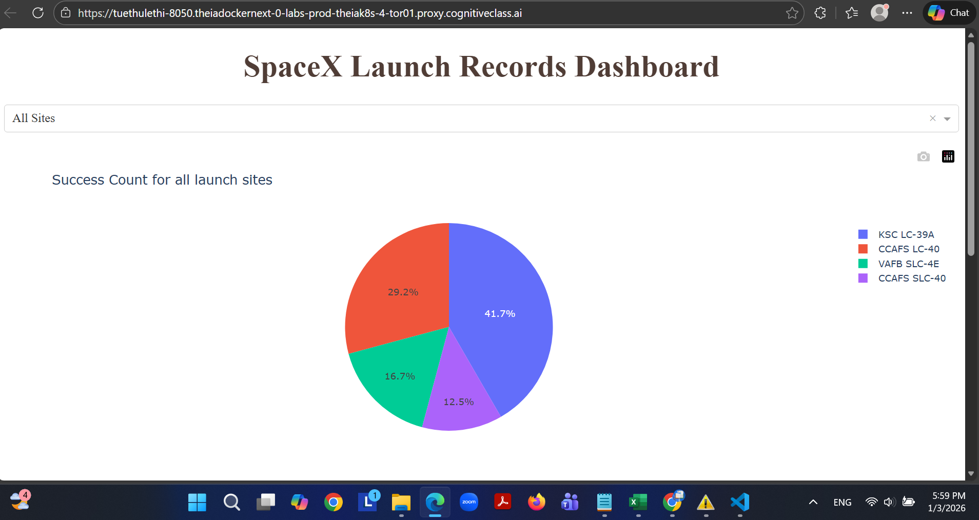
We observe that KSC LC‑39A leads with a 41.7% success rate,
while CCAFS SLC‑40 has the lowest performance at just 12.5%.

Slide 41
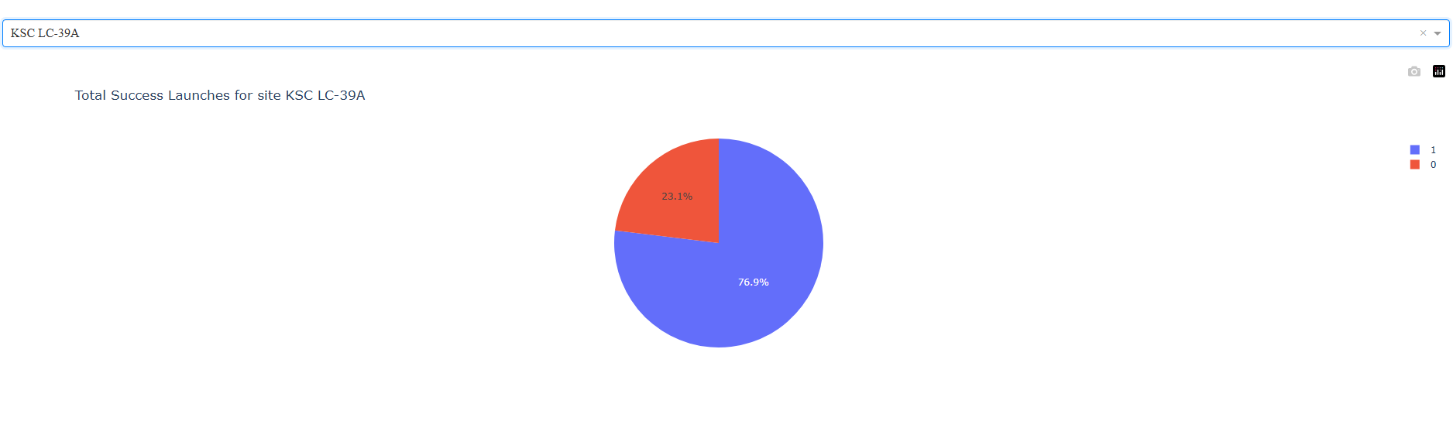
KSC LC‑39A
The pie chart for launch site KSC LC‑39A shows a launch success rate of nearly 77%, with 10 successful and only 3 failed landings.

Slide 42
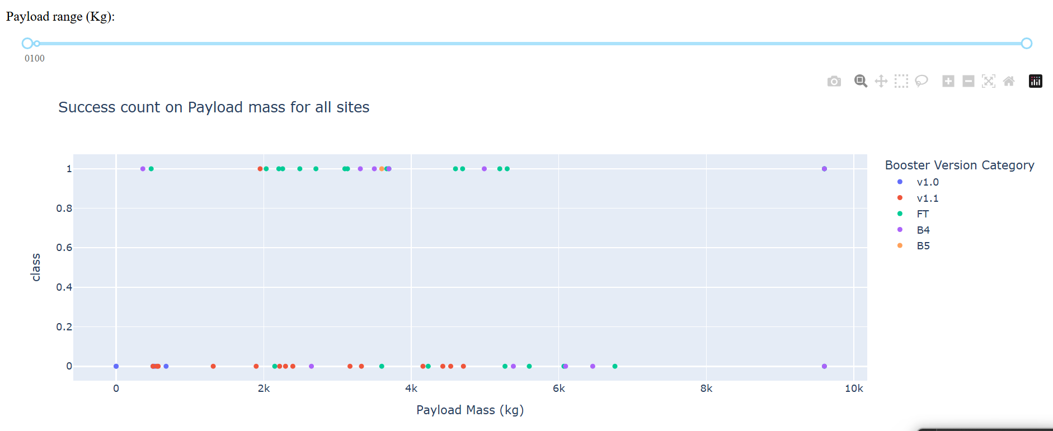
Payload vs. Launch Outcome
The data does not indicate a strong link between payload weight and success rate. Successes are more frequent in the “FT” and “B5” versions, whereas “v1.0” and “v1.1” show higher failure counts.
Even very heavy payloads—up to 10,000 kg—have been launched successfully.

Slide 43

Section 5

Slide 44
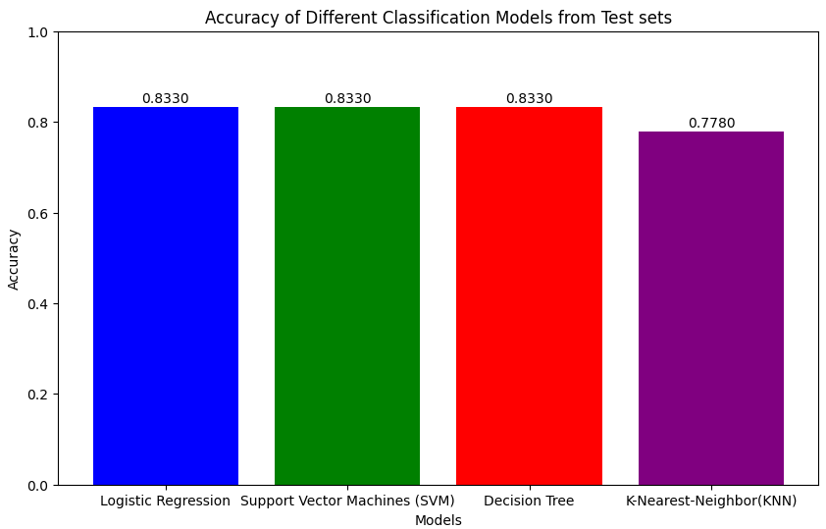
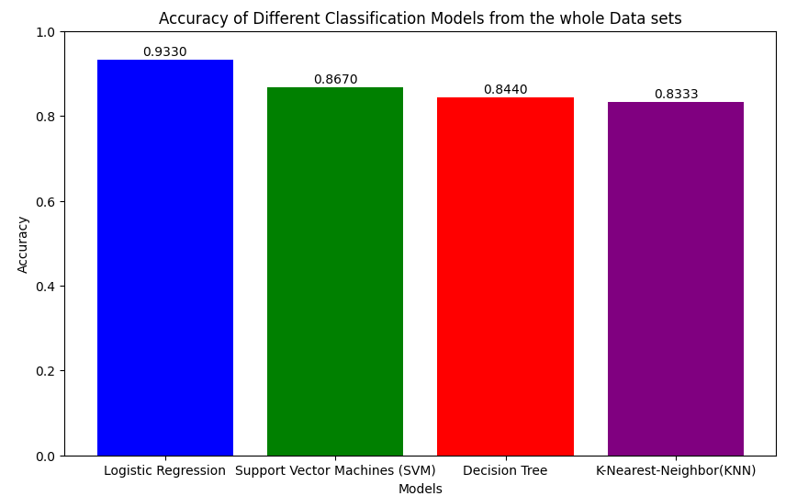
Classification Accuracy
Logistic Regression
83%
Support Vector Machines (SVMs)
83%
Decision Tree
83%
K-Nearest-Neighbor
77.8%
From the test set, we can see that Logistic Regression, Support Vector Machines (SVM), and Decision Tree all achieve similar performance at around 83% accuracy, while the K-Nearest Neighbor (KNN) model trails slightly with 78%.
However, when evaluating the full dataset, the differences become more pronounced. Logistic Regression performs the best with an accuracy of 93%, followed by SVM at 87%, the Decision Tree at 84%, and KNN at 83%.

Slide 45
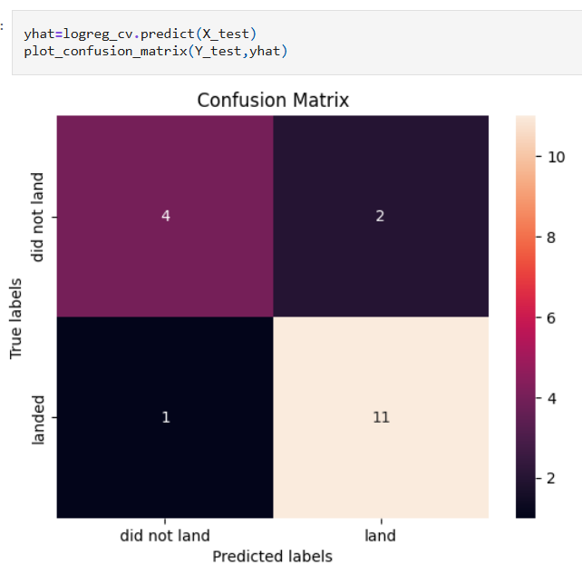
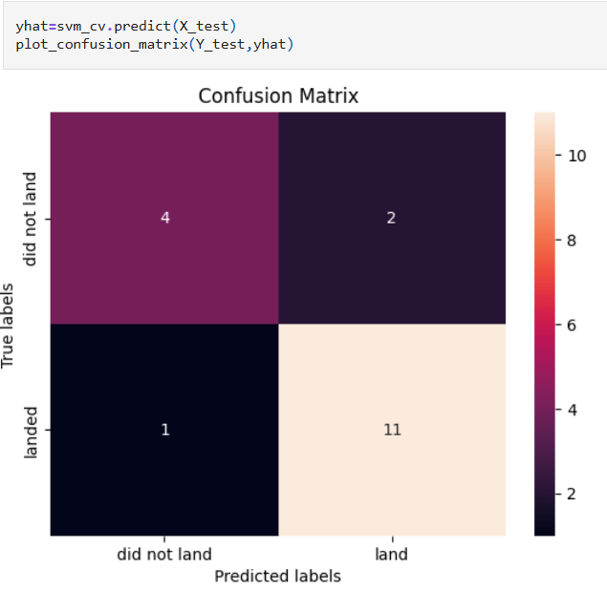
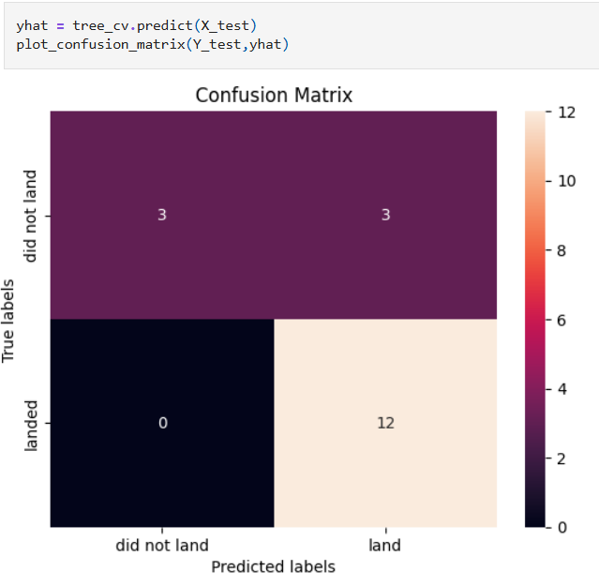
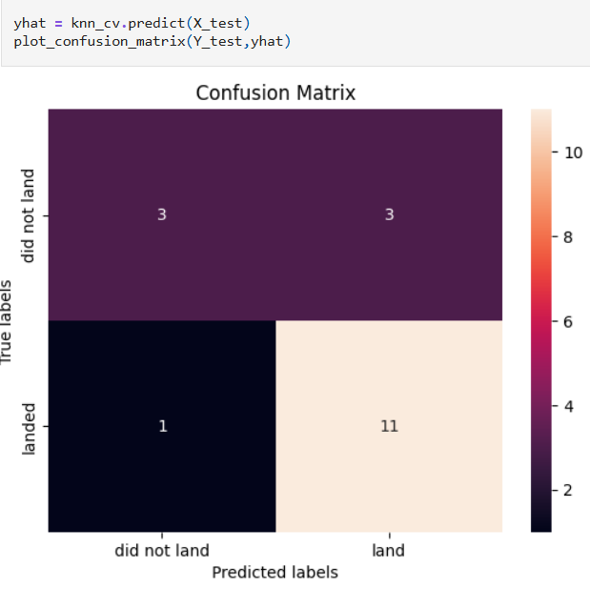
Confusion Matrix
Logistic Regression
-Correctly predicted 11 out of 12 landings and 4 out of 5 non-landings.
-Accuracy: 83%
→Best overall performance, with the most balanced results across both classes.
Support Vector Machines (SVMs)
-Predicted 11 out of 12 landings correctly, but only 2 out of 6 non-landings.
-Accuracy: 83%
→Same accuracy performance with Logistic Regression
Decision Tree
-Perfectly predicted all 12 landings, but misclassified 3 non-landings.
-Accuracy: 83%
→High recall for landings, but lower precision due to under-predicting “did not land".
K-Nearest-Neighbor
-Same performance as Decision Tree: 11 correct landings, 3 correct non-landings.
-Accuracy: 77.8%
→Matches Logistic Regression and SVMs in accuracy but shows more confusion in non-landed cases.
Notes:
What Each Model Means: Logistic Regression: A linear model that estimates probabilities for binary outcomes. It's simple, interpretable, and often surprisingly effective.
Support Vector Machines (SVM): A powerful classifier that finds the optimal boundary between classes. Good for high-dimensional data but sensitive to parameter tuning.
Decision Tree: A flowchart-like model that splits data based on feature thresholds. Easy to visualize but prone to overfitting.
K-Nearest Neighbors (KNN): A non-parametric model that classifies based on the majority label among the nearest data points. Simple but can struggle with noisy or imbalanced data.

Slide 46
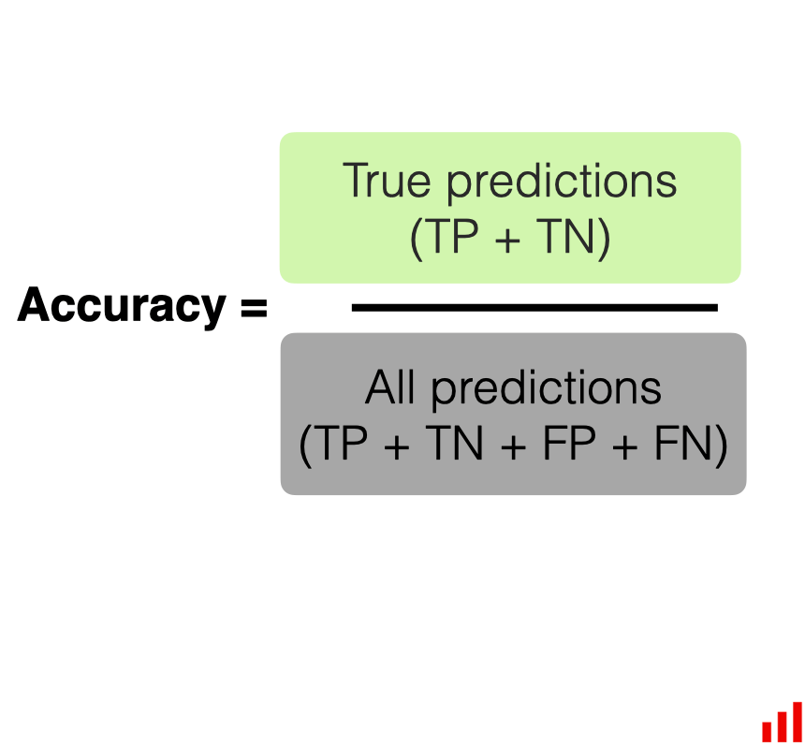
TN
FP
FN
TP
Confusion
Matrix
DID
NOT
LAND
ACTUAL
LANDED
DID NOT LAND
LANDED
PREDICTED

Slide 47
Conclusions
Regarding launch sites, KSC LC‑39A shows the highest success rate, particularly for missions carrying payloads above 2,500 kg. Several factors may contribute to this performance, such as its proximity to the equator or major transportation infrastructure, though these influences would require further investigation.
In terms of orbit types, ES‑L1, GEO, HEO, and SSO demonstrate significantly higher mission success rates compared with other orbits.
The scatter plots indicate positive relationships between the number of flights, launch site, orbit type, and the likelihood of a successful landing. Payload mass, however, does not show a clear correlation with mission success.
The steady increase in success rates from 2013 to 2020 reflects continuous learning, engineering improvements, and ongoing innovation, with the first successful landing recorded on 2015‑12‑22. Across the dataset, there were 61 successful missions and only 10 failures.
Using interactive visual analytics with Folium, we can observe geographical patterns: launch sites located near railways, coastlines, highways, or closer to the equator tend to operate more efficiently. At the same time, sites are intentionally placed far from major cities to reduce risks related to failures, noise, shockwaves, explosive fuels, and airspace disruption.
From the machine learning perspective, models such as Logistic Regression, Support Vector Machines (SVM), and Decision Trees achieve around 83% accuracy, confirming that reusable rocket landings can be predicted reliably using supervised learning. The K‑Nearest Neighbor (KNN) method performs slightly worse in comparison.
Overall, this project highlights the strong potential of AI in real‑world aerospace applications. It demonstrates how data science can analyze current conditions, identify the key factors influencing SpaceX’s launch success, and support more informed decision‑making in the reusable rocket industry.

Slide 48


